Slide 1


Cloud Computing with Azure
PRESENTED BY SAREEN FATIMA

Slide 2
Understanding Cloud Computing Basics
Cloud computing enables on-demand access to computing resources via the internet, allowing businesses to scale efficiently and reduce costs.
Characteristice: On-Demand Service | Scalability | Pay-as-you-go model
Cloud Deployment Models
PUBLIC CLOUD
PRIVATE CLOUD
HYBRID CLOUD
Cloud Service Models
IAAS (INFRASTRUCTURE AS A SERVICE)
PAAS (PLATFORM AS A SERVICE)
SAAS (SOFTWARE AS A SERVICE)

Slide 3

IAAS (INFRASTRUCTURE AS A SERVICE)
AZURE VIRTUAL MACHINES
AZURE VIRTUAL NETWORK
AZURE VIRTUAL NETWORK GATEWAY
NETWORK SECURITY GROUP (NSG)
AZURE BACKUP
RECOVERY SERVICES VAULT
TOGETHER, THESE SERVICES ENABLE SECURE VIRTUAL MACHINES, NETWORKING, CONNECTIVITY, TRAFFIC CONTROL, AND RELIABLE BACKUP WITHIN AZURE’S INFRASTRUCTURE ENVIRONMENT.

Slide 4
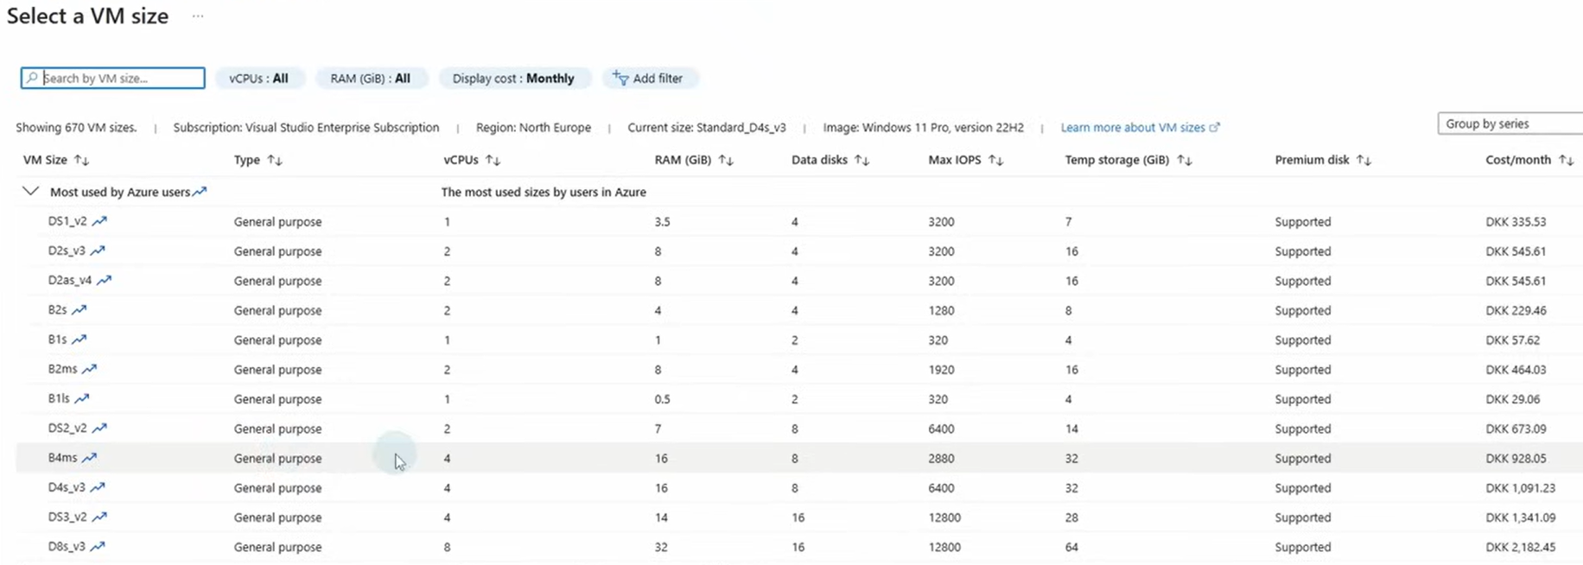

Virtual Machine Sizes

Slide 5
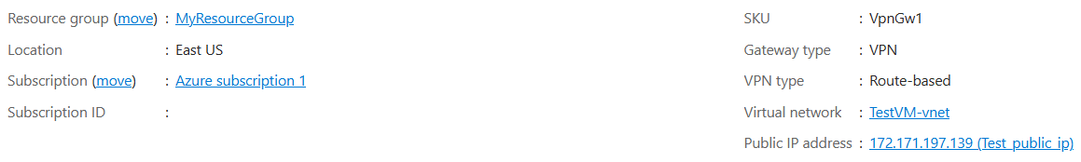
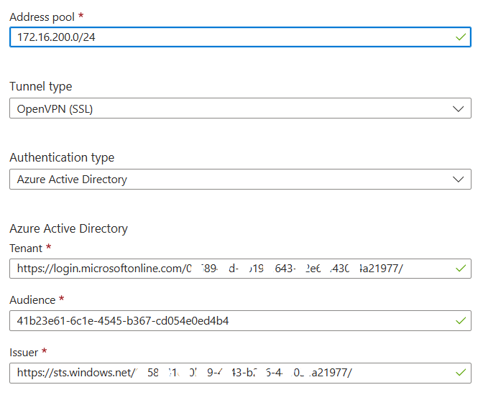
AZUES VIRTUAL NETWORK GATEWAY

Slide 6
PAAS (PLATFORM AS A SERVICE)
AZURE APP SERVICE
AZURE APP SERVICE PLAN
AZURE LOGIC APPS
PROVIDES A MANAGED PLATFORM TO BUILD, DEPLOY, AND SCALE APPLICATIONS. WORKFLOWS AND INTEGRATIONS ARE AUTOMATED WHILE AZURE HANDLES THE INFRASTRUCTURE.

Slide 7
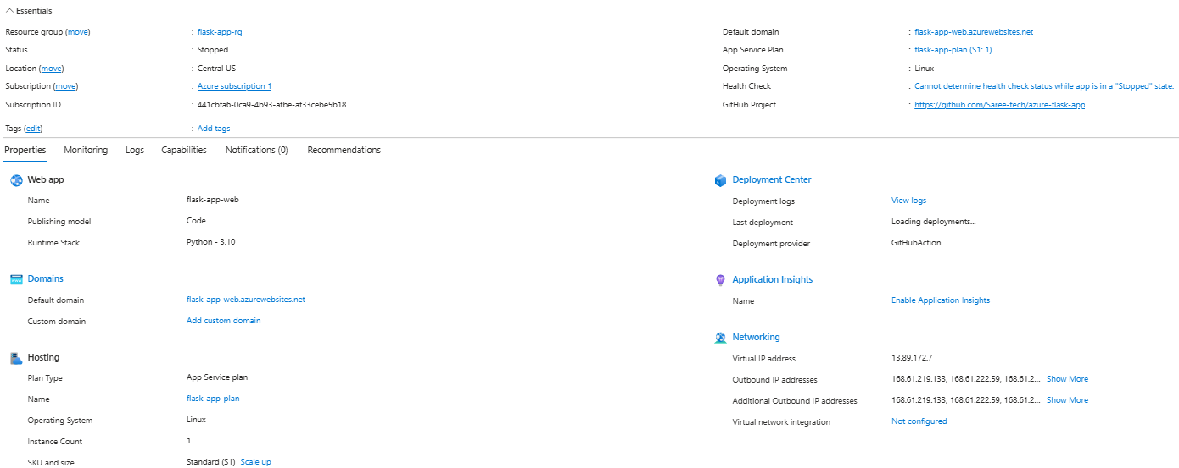
AZURE APP SERVICES

Slide 8
SAAS (SOFTWARE AS A SERVICE)
MICROSOFT INTUNE
MICROSOFT 365 BUSINESS PREMIUM
MICROSOFT ENTRA ID
MICROSOFT DEFENDER
PROVIDES FULLY MANAGED SOFTWARE APPLICATIONS ACCESSIBLE OVER THE INTERNET. USERS CAN FOCUS ON USING APPS WHILE MICROSOFT HANDLES SECURITY, UPDATES, AND INFRASTRUCTURE.

Slide 9
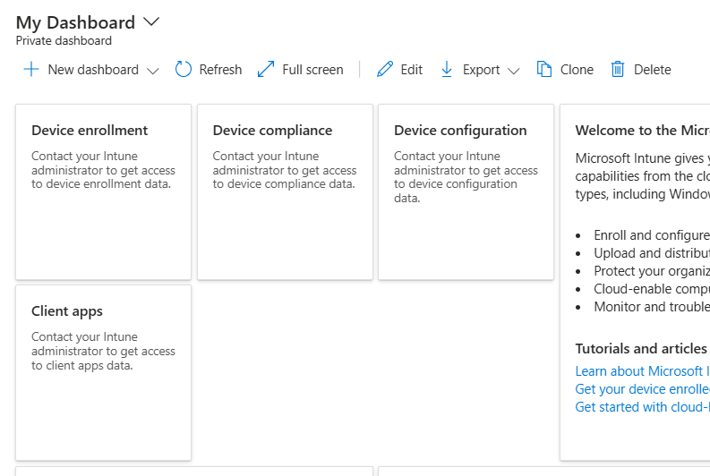
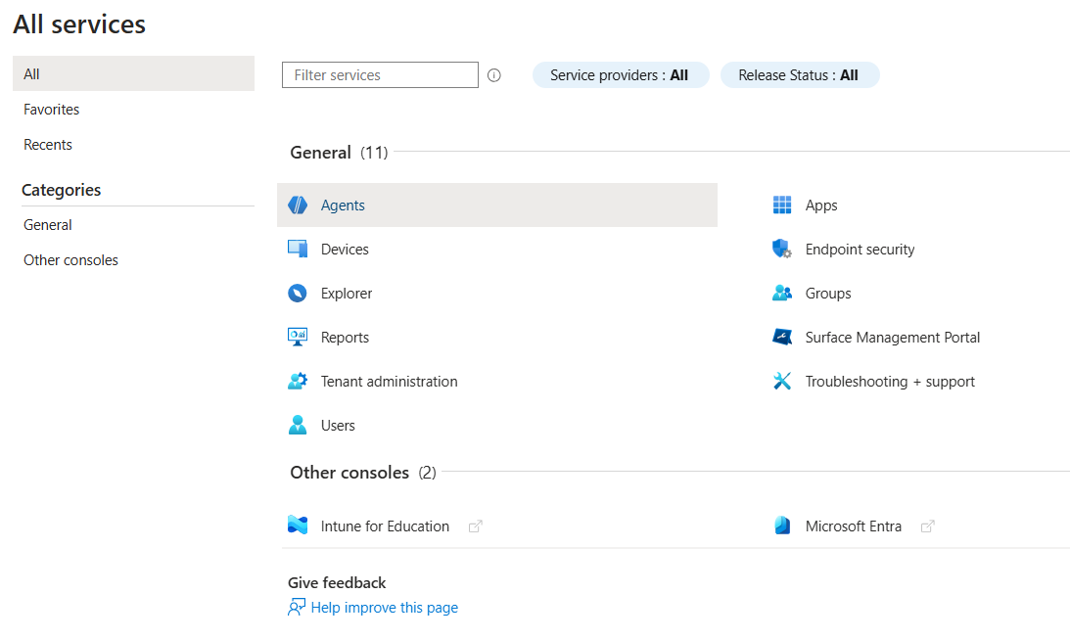
INTUNE

Slide 10
💳 Cloud Payments & Billing
🔹 PRICING MODEL
PAY-AS-YOU-GO
SUBSCRIPTION / RESERVED PLANS
🔹 FREE TIER
LIMITED FREE SERVICES & CREDITS
IDEAL FOR LEARNING AND TESTING
🔹 RESOURCE MONITORING
PREVENTS UNEXPECTED CHARGES
AVOIDS PAYING FOR UNUSED RESOURCES
ENABLES COST OPTIMIZATION

Slide 11


Any Question

